Slide 1
Quality Match
Bicycle project crowd evaluation
By Nguyen Duc Tuan

Slide 2
Task 1 - a. Annotators
Total of 22 annotators:
annotator_01
annotator_02
annotator_03
annotator_04
annotator_05
annotator_06
annotator_07
annotator_08
annotator_09
annotator_10
annotator_11
annotator_12
annotator_13
annotator_14
annotator_15
annotator_16
annotator_17
annotator_18
annotator_19
annotator_20
annotator_21
annotator_22

Slide 3
Task 1 - b. Annotation time
Initially, the minimum and maximum annotation time were found as following:
Min duration: -99999 ms
Max duration: 42398 ms
All the values “-99999” ms are considered as data issue and are removed from the dataset.
Additionally, results that are marked as corrupted were also removed.

Slide 4
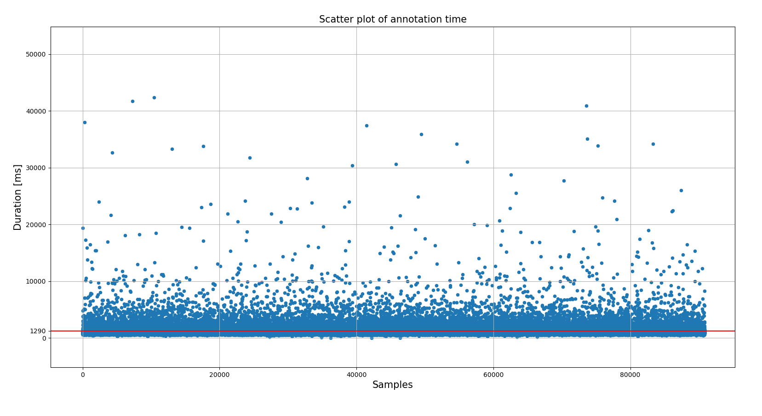
Task 1 - b. Annotation time
With data issue and ‘corrupt_data’ removed
(measured in ms)
mean | 1289.94
std | 1124.01
min | 10.00
25% | 887.00
50% | 1058.00
75% | 1328.00
max | 42398.00

Slide 5
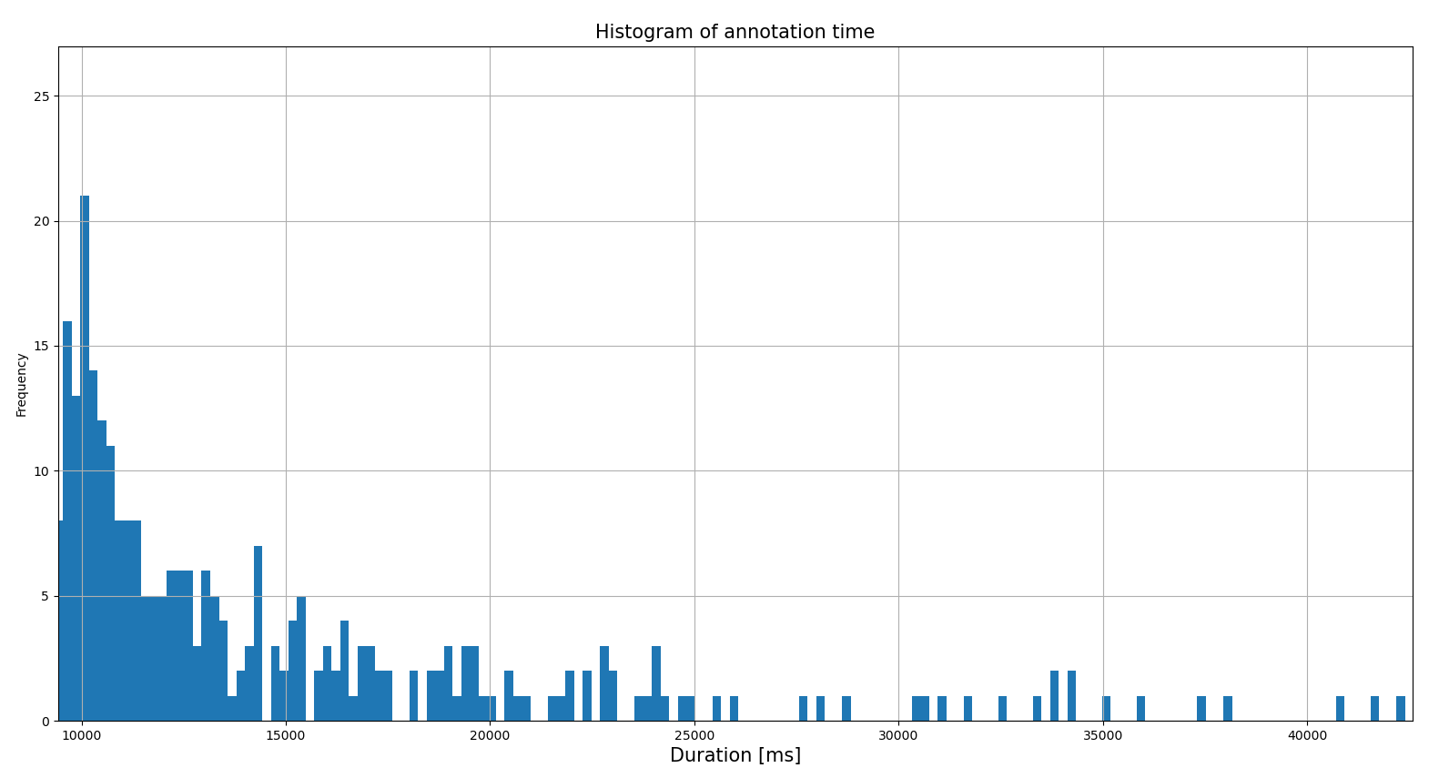
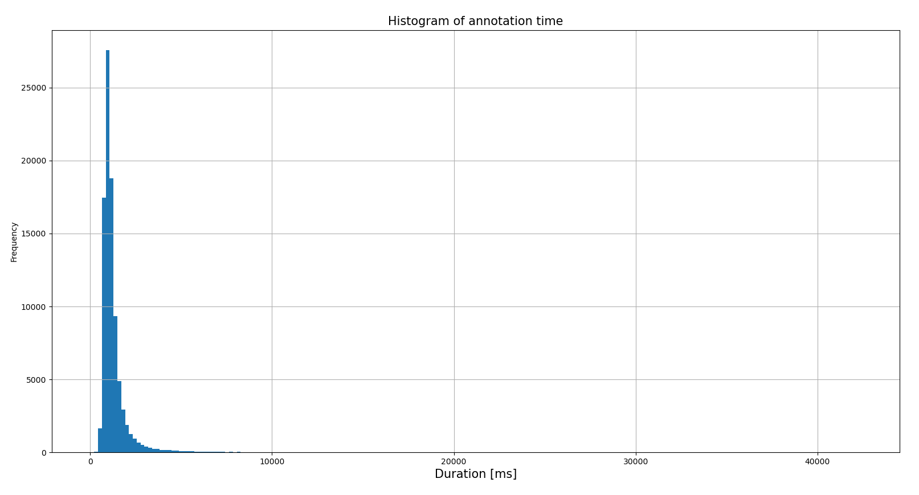
Task 1 - b. Annotation time
Histogram plot

Slide 6
Task 1 - b. Annotation time
Annotation time sorted by annotators
Max annotation time | 42398.00 ms | annotator_06
Min annotation time | 10.00 ms | annotator_04
Max average annotation time | 1687.78 ms | annotator_19
Min average annotation time | 879.43 ms | annotator_22

Slide 7
Task 1 - b. Annotation time
Annotation time sorted by images
Max annotation time | 42398.00 ms | img_5245
Min annotation time | 10.00 ms | img_5100
Max average annotation time | 5577.50 ms | img_1340
Min average annotation time | 738.90 ms | img_8427

Slide 8




Task 1 - b. Annotation time
Images
img_5245
img_5100
img_1340
img_8427
Max annotation time by an annotator
Min annotation time by an annotator
Max average annotation time
Min average annotation time

Slide 9
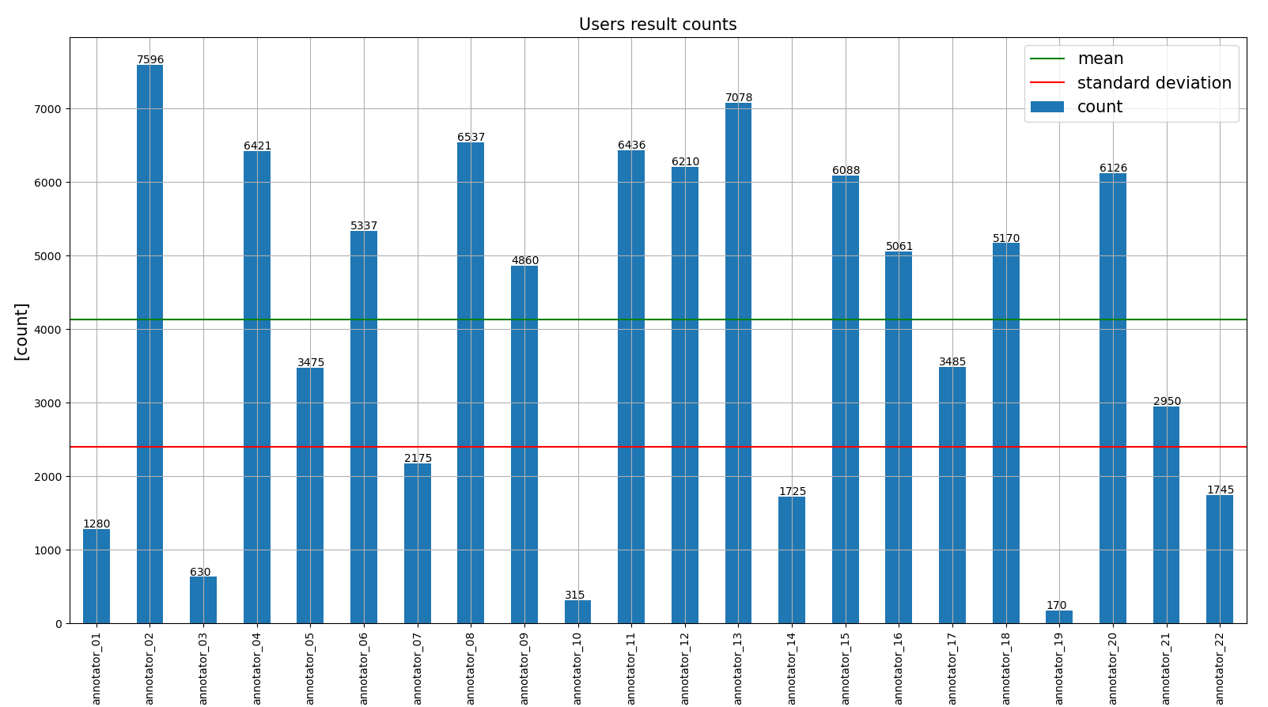
Task 1 - c. Annotators’ results
There are huge differences between the sample sizes of each annotator. Some annotators have up to approximately 6000 samples, while some others have only less than 500 samples.
The sample size will be used as one of the attributes to evaluate the performance of the annotator.
(measured in samples)
mean | 4130.45
std | 2403.23
min | 170.00
25% | 1852.50
50% | 4960.50
75% | 6189.00
max | 7596.00

Slide 10
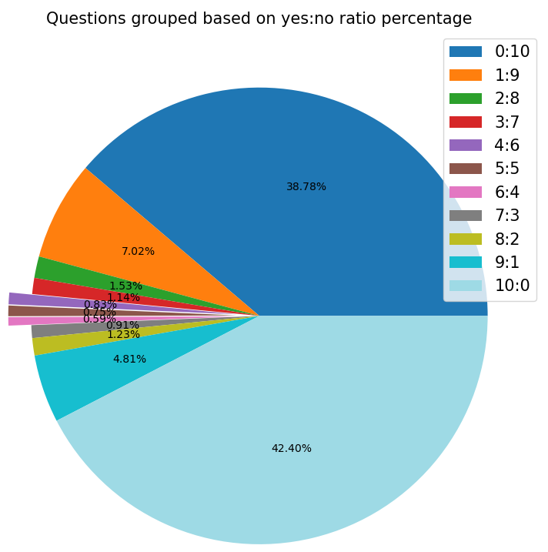
Task 1 - d. Highly disagree questions
The highly disagree rate is decided based on the ratio of yes/no answers of each image
The sum of group 4:6, 5:5 and 6:4 indicates approximately 2.17% of the total questions are highly disagreed.
yes:no | count | percent
0:10 | 3524 | 38.78%
1:9 | 638 | 7.02%
2:8 | 139 | 1.53%
3:7 | 104 | 1.14%
4:6 | 75 | 0.83%
5:5 | 68 | 0.75%
6:4 | 54 | 0.59%
7:3 | 83 | 0.91%
8:2 | 112 | 1.23%
9:1 | 437 | 4.81%
10:0 | 3853 | 42.40%

Slide 11
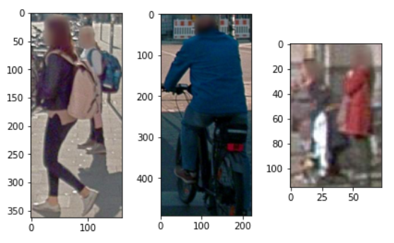
Task 1 - d. Highly disagree questions
Examples of highly disagree questions

Slide 12
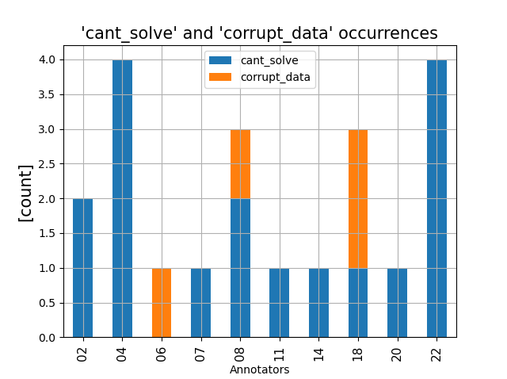
Task 2 - ‘cant_solve’ and ‘corrupt_data’
The percentages of 'cant_solve' and 'corrupt_data' to happen are 0.0187% and 0.0044% respectively.
vendor_user_id | cant_solve _percent | corrupt_data _percent
annotator_02 | 0.0263% | 0.0000%
annotator_04 | 0.0623% | 0.0000%
annotator_06 | 0.0000% | 0.0187%
annotator_07 | 0.0460% | 0.0000%
annotator_08 | 0.0306% | 0.0153%
annotator_11 | 0.0155% | 0.0000%
annotator_14 | 0.0580% | 0.0000%
annotator_18 | 0.0193% | 0.0387%
annotator_20 | 0.0163% | 0.0000%
annotator_22 | 0.2292% | 0.0000%
'annotator_04' and 'annotator_22', each marked 4 samples as 'cant_solve'.
'annotator_18' is the one made use of the option 'corrupt_data' most (2 samples).
There is no repetition of any sample among those marked with 'cant_solve' and 'corrupt_data'. Each sample in this region is unique.
These numbers can be considered as immaterial as their percentages are insignificant.

Slide 13
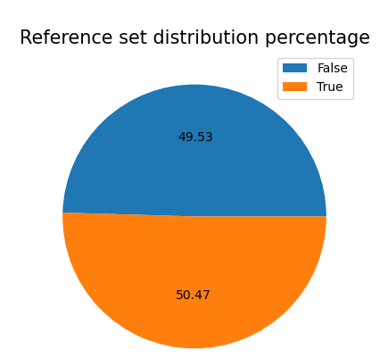
Task 3 - Reference set balance
Conclusion: the reference set is balanced.
is_bicycle | count
False | 4501
True | 4586

Slide 14
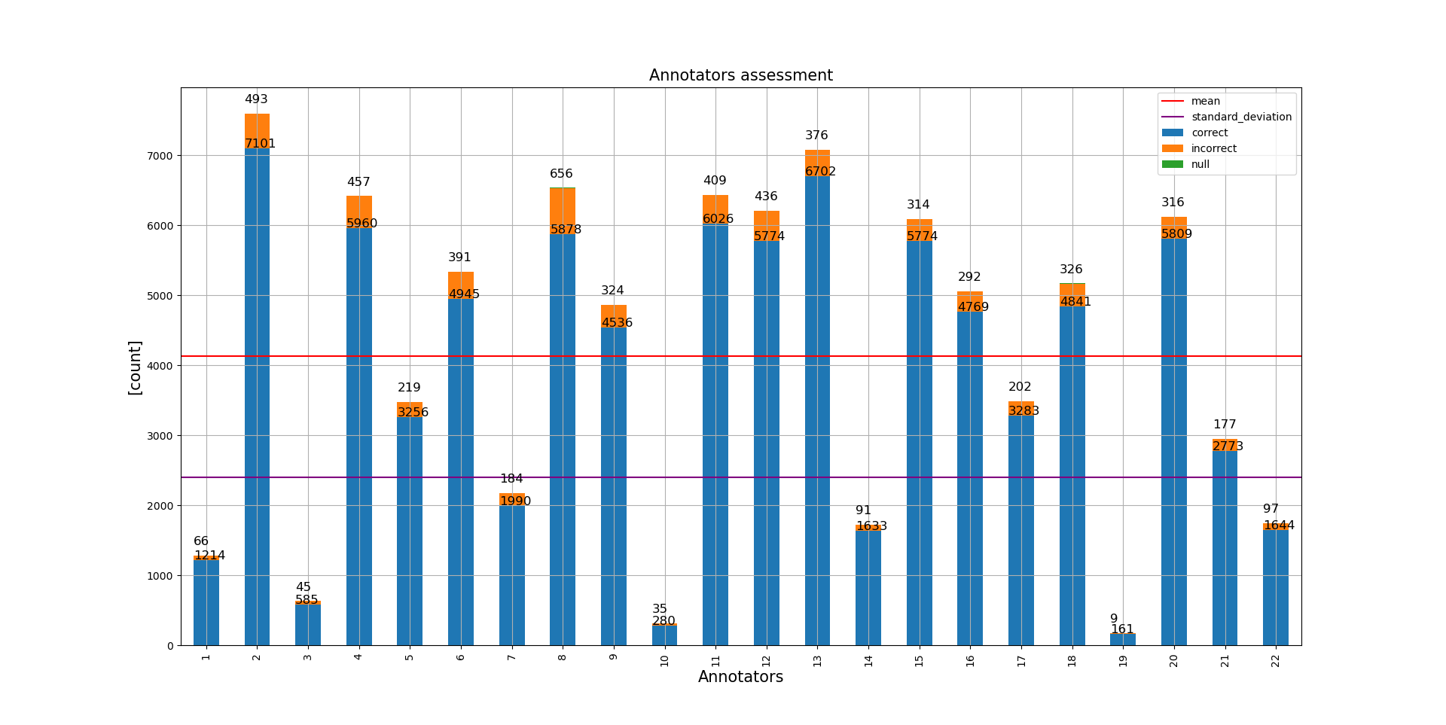
Task 4 - Annotators’ results assessment
Note: ‘null’ is used to indicate samples with ‘cant_solve’ or ‘corrupt_data’ are labeled as True

Slide 15
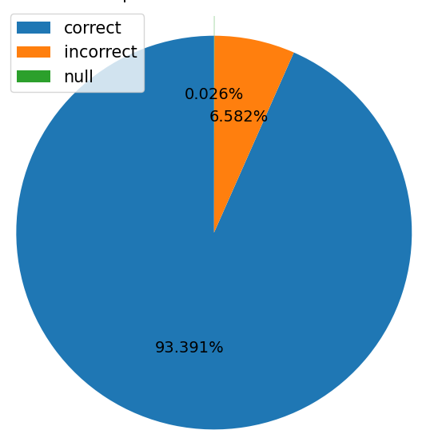
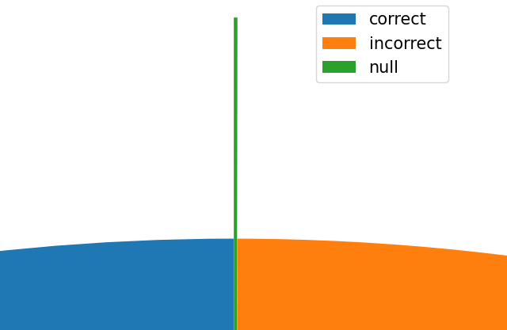
Task 4 - Annotator average result assessment

Slide 16
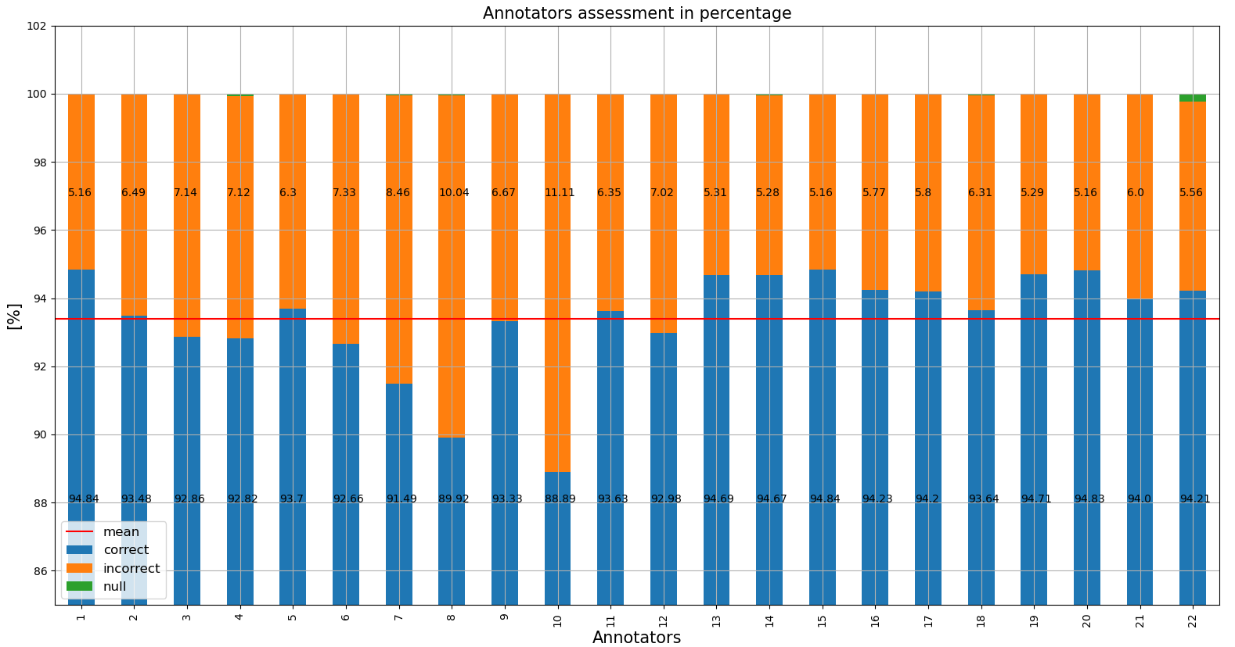
Task 4 - Annotators’ results assessment
Initially, all annotators are taken in to evaluation. From the percentage graph, the annotators are sorted into 2 groups, good and bad annotators, based on their individual correct percentages comparing with the average correct percentage (93.39%).
min | 88.89 %
max | 94.84 %
mean | 93.39 %
Good annotators:
01, 13, 14, 15, 16, 17, 19, 20
Bad annotators:
07, 08, 10

Slide 17
Task 4 - Annotators’ results assessment
The assessment is unfair as some annotators’ total samples are far below the average.
E.g.: annotator_01 is assessed as good while his/her total sample is only ~1200 comparing to annotator_02 with more than 7000 samples.
In order to evaluate correctly, only the annotators whose sample sizes are greater than the standard deviation value σ = 2403.23 are selected.

Slide 18
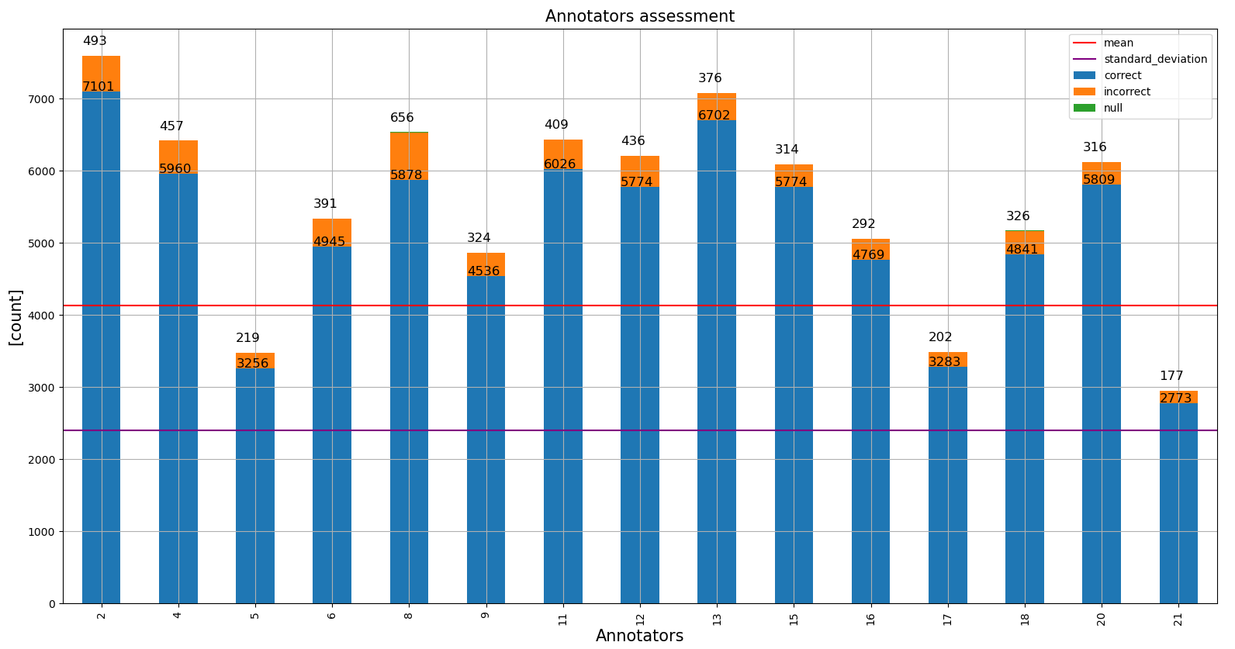
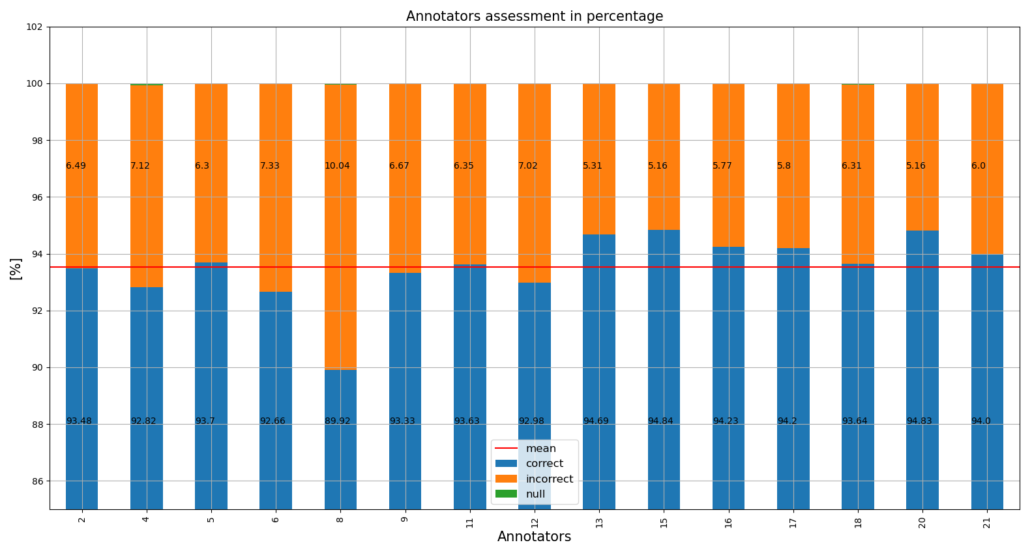
Task 4 - Annotators’ results assessment
With this change, the good and bad annotators are reconsidered. In particular, despite the high correct percentages, annotator_01 and annotator_14 are removed from the good annotators group as their sample sizes are too small. Annotator_21 is taken into consideration.
The bad annotator group removed annotator_07 and annotator_10 with the same reason and add 3 new annotators, annotator_04, annotator_06 and annotator_12.
New good annotators: 13, 15, 16, 17, 20, 21 - New bad annotators: 04, 06, 08, 12

Slide 19
Task 4 - Annotators’ results assessment
From inspection, annotator_13 and annotator_20 are considered as good annotators as their sample sizes are far above the average level of 4130 samples. Their correct percentages are more than 94% (nearly 95%), higher than the average of 93.52%. Their annotation times are also below the average, which is 1289.9 ms.
Despite the fast average annotation time and high accuracy of 94%, the low sample size make it difficult to make a conclusion of the performance of annotator_17.
vendor_user_id | mean_duration | result_count | correct_p
annotator_13 | 1155.01 | 7078 | 94.69
annotator_15 | 1365.29 | 6088 | 94.84
annotator_16 | 1269.79 | 5061 | 94.23
annotator_17 | 991.89 | 3485 | 94.20
annotator_20 | 1173.15 | 6126 | 94.83
annotator_21 | 1238.92 | 2950 | 94.00

Slide 20
Task 4 - Annotators’ results assessment
All four annotators have high sample size with the accuracy below the average of 93.52%. However, beside annotator_08, the others three have the accuracy of 92%, which is close to the average line.
Only annotator_08 has the lowest accuracy percentage of 89.9% and high average annotation time of 1434 ms. This causes annotator_08 to be considered as low performance annotator.
vendor_user_id | mean_duration | result_count | correct_p
annotator_04 | 1113.93 | 6421 | 92.82
annotator_06 | 1496.94 | 5337 | 92.66
annotator_08 | 1434.70 | 6537 | 89.92
annotator_12 | 1306.31 | 6210 | 92.98

Slide 21
End.
Thank you for your time.

